Slide 1
FLYNN'S TAXONOMY
Classifying computers – how, when and why

Slide 2
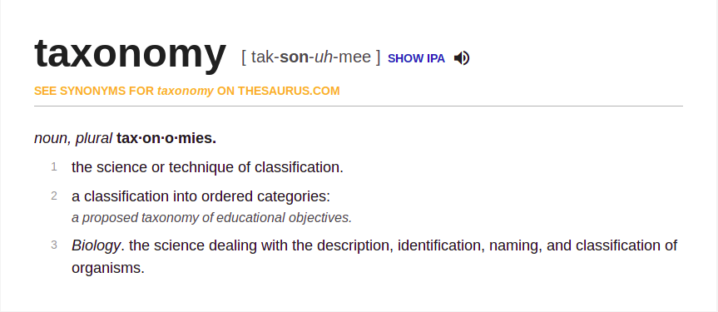
WHAT IS A TAXONOMY?

Slide 3
WHY SHOULD WE CLASSIFY COMPUTERS?

Slide 4
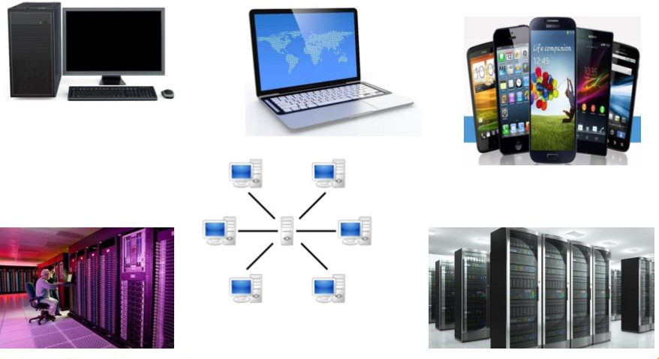
1.To understand what has already been achieved
Computers have come a long way today from Babbage's Analytical engine, and we need to establish how we can systematically study them.

Slide 5
2.To reveal possible configurations that may not have occurred to a systems designer
Only after classifying the existing solutions and studying them, the gaps can be identified which can suggest other possibilities.

Slide 6
3.To allow useful models of performance to be built and used
Classification on a distinct basis may reveal why a particular architecture is likely to improve performance.
Characterization in scrutiny serves as a model for performance analysis.

Slide 7
Our primary interest in a parallel computer taxonomy is to :
Help understand pertinent issues raised by parallel computing hardware
Quantify completeness of argument – By analyzing every leaf in a taxonomy, we can quantify completeness of argument(in applicability of technology,etc.)

Slide 8
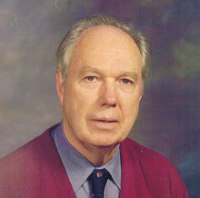
Michael J. Flynn
American Professor emeritus, Stanford University
Founded IEEE Computer Society's technical committee on Computer Architecture
Founded ACM's Special Interest group on Computer Architecture
Winner of prestigious Harry H. Goode Memorial Award, Eckert-Mauchley Award and Tesla Medal
Most known for proposing Flynn's Taxonomy.

Slide 9
What is Flynn's Taxonomy?

Slide 10
A stream is defined as a sequence of items.
On the basis of the instruction stream and the data stream, Flynn classifies computers into 4 categories :
SISD
SIMD
MISD
MIMD

Slide 11
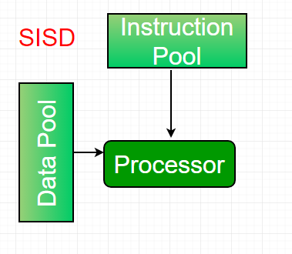
SISD – Single Instruction, Single Data
Uniprocessor machine
Processes instructions sequentially
All data has to be stored in the primary memory
E.g. Von Neumann Architecture

Slide 12
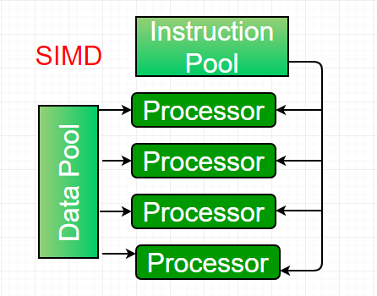
SIMD – Single Instruction, Multiple Data
Multiprocessor machine
Multiple processing elements perform same operation on multiple data points simultaneously
Well-suited for vector and matrix operations
E.g. CRAY's Vector Processing Machine

Slide 13
How SIMD works
Instead of concurrency, SIMD machines exploit data-level parallelism
Data-level parallelism is a form of parallel computing where data is distributed across different parallel nodes for simultaneous computation
Since only one instruction is executed across multiple data, it is used prevalently in audio/image processing, improving performance in multimedia usage, etc.

Slide 14
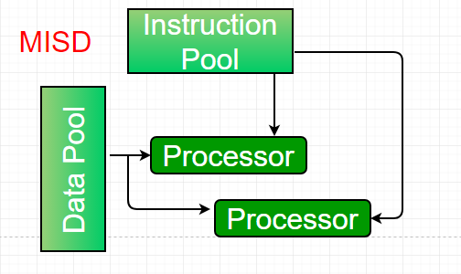
MISD – Multiple Instruction, Single Data
Multiprocessor machine
Same dataset, different instructions, e.g. z = sin(x) + cos(x) + tan(x)
Non-existent in any commercial usage
Added to quantify completeness

Slide 15
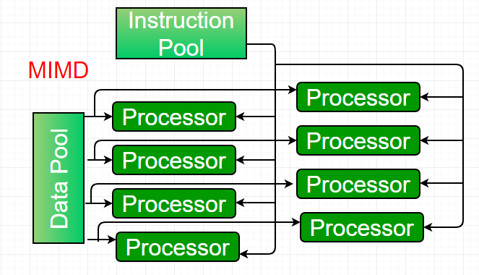
MIMD – Multiple Instruction, Multiple Data
Multiprocessor machine
Processing elements work asynchronously and independently
At any point of time, different processing elements perform different operations on different data
Capable to any kind of application
E.g. Intel Xeon Phi

Slide 16
MIMD is further subcategorized into :
Shared-Memory MIMD
Distributed Memory MIMD

Slide 17
Shared-Memory Architecture
Multiple processors operate independently, but share the same memory resources
Changes made in a memory location by one processor is visible to all other processors

Slide 18
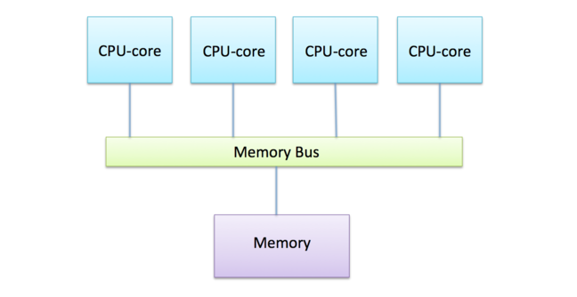
How Shared-Memory Architecture works
A special fast inter-connection network allows any processor to access any part of the memory in parallel
Processors communicate via main-memory, making it very efficient
Since all processing elements come under the same Operating System, load balancing is also taken care of

Slide 19
Shared-Memory Architecture can be further subcategorized into :
Uniform Memory Access (UMA)
Non-Uniform Memory Access (NUMA)

Slide 20
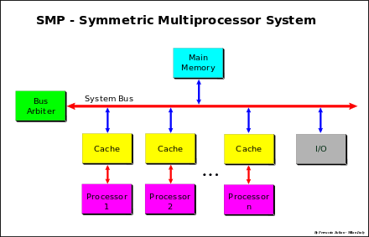
SMP – Symmetric Multiprocessing
A computer hardware/software architecture where multiple cores/processors are :
Connected to a single, shared main-memory
Have full access to all input/output devices
Are connected to a single Operating System that treats all cores/processors equally

Slide 21
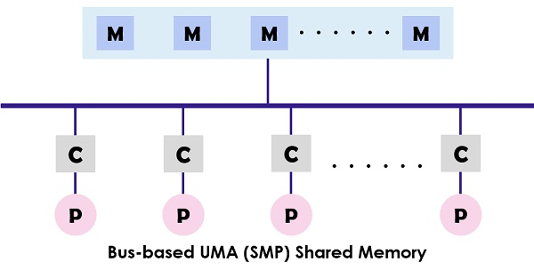
Uniform Memory Access (UMA)
Most prevalently implemented as bus-based SMP machines
Memory Access time is balanced/equal
UMA is cache coherent – If one processor updates a location in shared memory, all other processors know about the update

Slide 22
UMA can also be implemented by :
Using Crossbar switches
Using Multistage interconnection networks

Slide 23
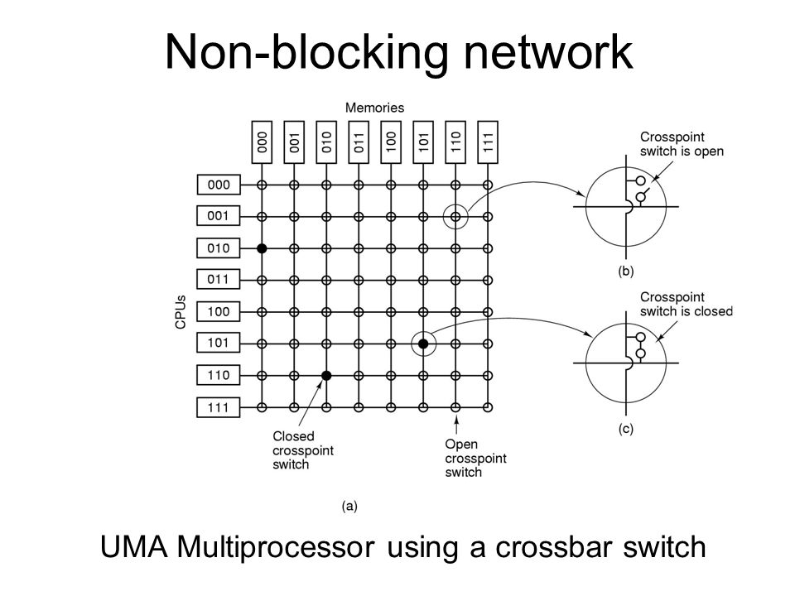
UMA using crossbar switches

Slide 24
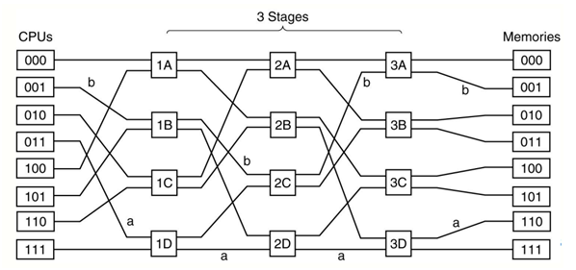
UMA using Multistage Interconnection Networks

Slide 25
hUMA – Heterogeneous UMA
Relatively new concept, surfaced around 2013
Refers to CPU and GPU sharing same system memory with cache coherency
Advantageous because of an easier programming model and less copying of data between memory pools

Slide 26
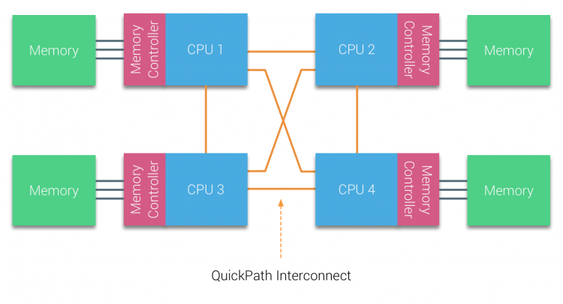
Non-Uniform Memory Access (NUMA)
Physical linking of 2 or more SMPs, one can directly access the other
Memory Access time is dependent on memory location relative to the processor
If cache coherency is maintained, it is called CC-NUMA

Slide 27
Shared-Memory Architecture
PROS
User-friendly programming perspective
Data sharing between tasks is fast and uniform
CONS
Lack of scalability in memory and CPUs
Programmer is responsible for synchronization

Slide 28
Distributed-Memory Architecture
A communication network is used to access inter-connected memory
Multiprocessor system where processors have own local memory and operate independently

Slide 29
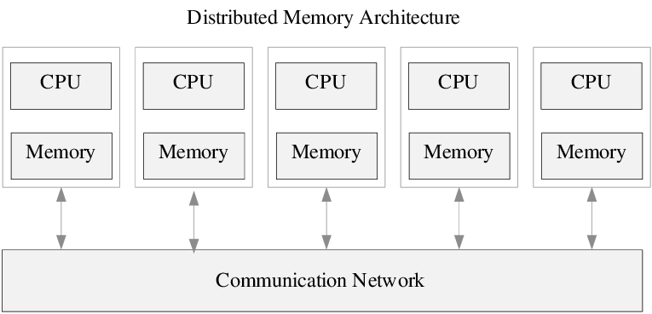
How Distributed-Memory works
Computational tasks can only use local data
If remote data is required, the program must communicate with the remote processors
Processors need not be aware of where data resides
The interconnect is in the form of point-to-point links, or a switching network

Slide 30
Distributed-Memory Architecture
PROS
Memory is scalable with number of processors
Processors can rapidly access own memory without interference
CONS
Programmer is responsible for details of communication between processors
No overhead of maintaining global cache coherency
Cost Effective
Difficult to map existing data structures based on global memory to this memory organization
Data on remote node has longer access time than local data

Slide 31
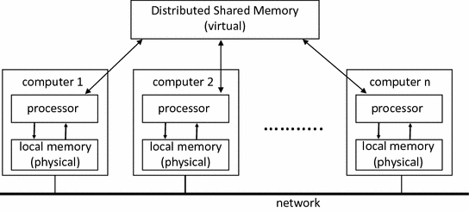
Distributed-Shared Memory Architecture
There is also a hybrid Distributed-Shared Memory Architecture
Shared-Memory component may be a Shared-Memory machine/GPU
Distributed-Memory component may be networking of multiple Shared-Memory machines/GPUs, that only know of their own memory
Hides mechanism of communication, but does not hide latency of communication

Slide 32
Takeaway from using each Memory Architecture
Shared-Memory
Unified memory address space where all data can be found
Highly efficient data sharing
Distributed-Memory
Excludes race conditions
Programmer has to think about data distribution as well as communication between processors
Shared-Distributed Memory
Very easy to design a machine that scales with the algorithm
Very high complexity for programmer
Programmer-friendly

Slide 33
Modification And Updation of Flynn's Taxonomy
As computers evolved, there came some designs that could not be accomodated. So Flynn's taxonomy was modified with 2 more categories...

Slide 34
The most important and most significant modification to Flynn's taxonomy was appending synchronization at the instruction level with synchronization at the program level
A program is defined as a set of instructions followed to perform a particular task
In this context, two more categories stemmed out in MIMD :
SPMD
MPMD

Slide 35
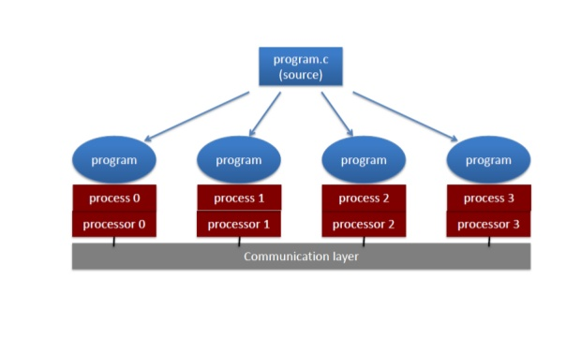
SPMD – Single Program, Multiple Data
Synchronization is established at the level of programs
While multiple cores/CPUs run the same program, they can execute different instructions of a program at the same time
Most common style of parallel programming

Slide 36
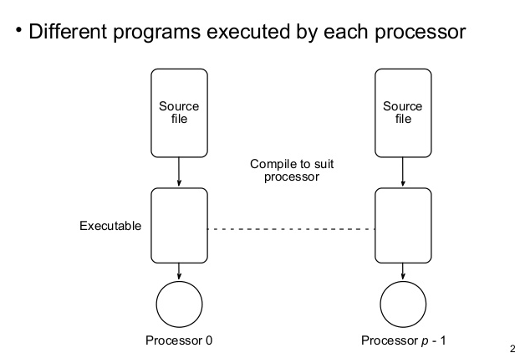
MPMD – Multiple Program, Multiple Data
Multiple autonomous processors operate on at least two independent programs simultaneously
Typically, one node acts as the "master" that runs one program, farming out data to all other "worker" nodes, which run a different program and return the results to the master node

Slide 37
Ambiguities in Flynn's Taxonomy
Just like any taxonomy, Flynn's taxonomy has a few debatable or controversial arguments...

Slide 38
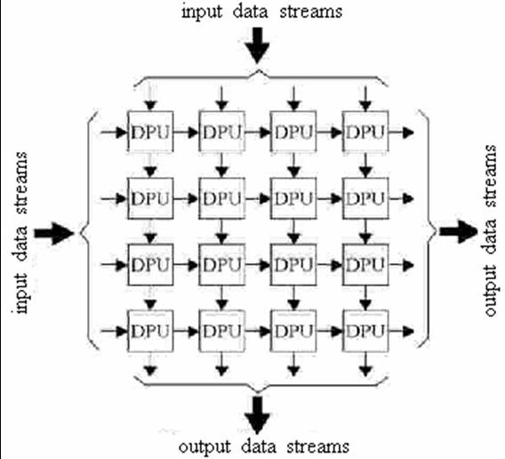
Systolic Arrays
Homogeneous network of tightly-coupled processors/nodes
Each node receives data from upstream, independently computes a partial result, stores the result within itself, and passes the data downstream

Slide 39
MISD – problematic classifications
Systolic Arrays are prevalently classified as MISD
This classification is problematic because since the data swarm is transformed as it passes through each node
Therefore the processors do not act on the same data, making the classification a misnomer

Slide 40
What do Systolic Arrays come under?
Since the input is typically a vector of independent values, the systolic array is definitely not SISD
Since these values are merged and combined into the result(s) and do not maintain their independence as they would in SIMD, the array cannot be classified as such
Consequently, the array cannot be classified as a MIMD either, because MIMD can be viewed as a mere collection of smaller SISD and SIMD machines
This kind of a misnomer also exists with pipeline architecture being classified as MISD

Slide 41
Systems classified as MIMD
Technically, every standard desktop computer today is an MIMD system, with each core/processor being SISD or SIMD
But purists argue for MIMD as only when parallelism is implemented at the hardware level(with thousands of cores/processors)
But such types of systems are not commercially available in any market, and only exist as research projects

Slide 42
Timelines of Computing Systems
And how Flynn's taxonomy has helped us classify and study them

Slide 43
1. SISD Systems
A brief overview

Slide 44
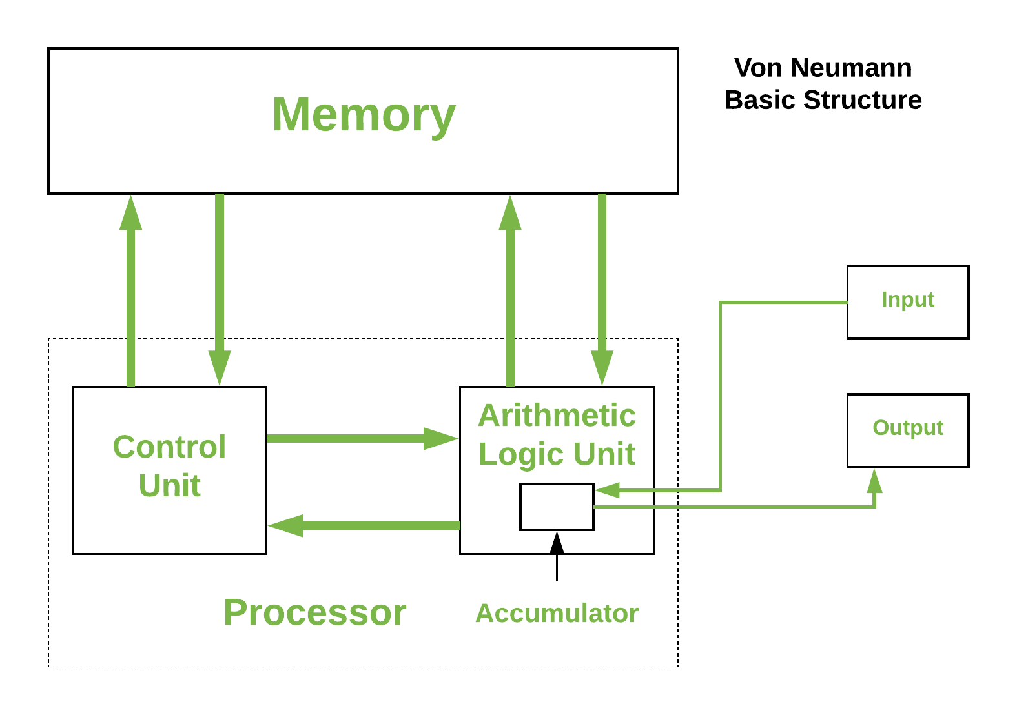
Von Neumann Architecture
Proposed in 1945
Architecture where the stored-program concept was first introduced
Refers to a stored program computer where instruction fetch and data operation cannot take place simultaneously as they share a common bus

Slide 45
Few systems that stemmed out from this architecture are :

Slide 46
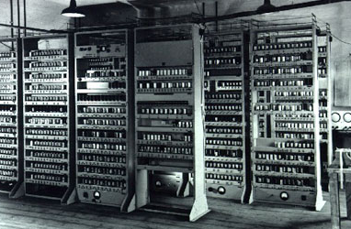
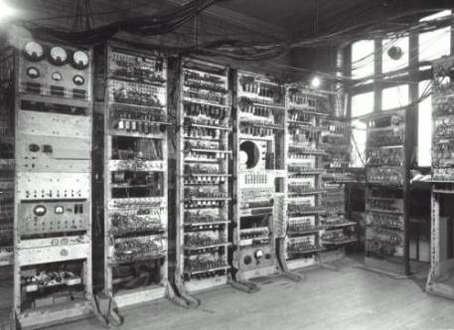
EDVAC, 1946
One of the earliest electronic computers
Designed to be a stored-program computer
Was a binary serial computer, unlike its predecessor ENIAC

Slide 47
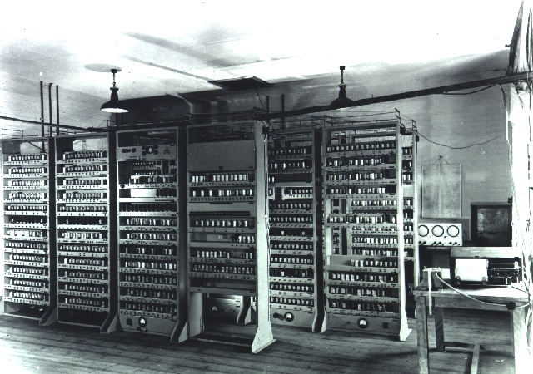
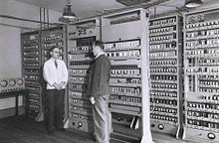
EDSAC, 1949
The second electronic, digital stored-program computer
Designed by Maurice Wilkes and team at University of Cambridge Mathematical Laboratory, England
Winners of 3 Nobel prizes have benefitted from the EDSAC's computing power

Slide 48
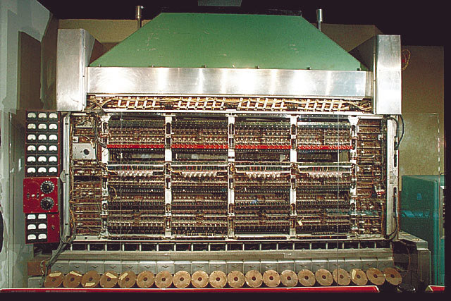
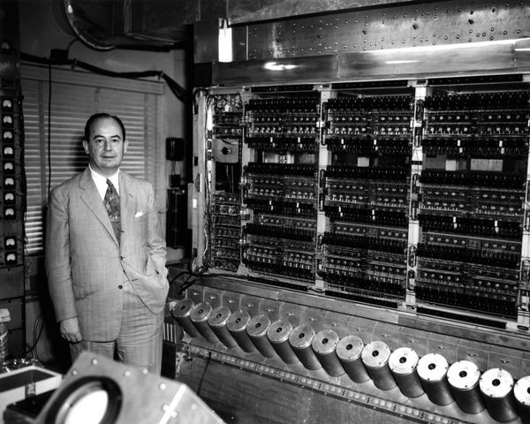
IAS Machine, 1952
First electronic computer to be built in Institute of Advanced Study, Princeton
Generally called Von Neumann Machine, since paper describing its design was edited by Von Neumann
The man on the right, posing with the IAS machine, is Von Neumann himself!

Slide 49
2. SIMD Systems
And how they have evolved

Slide 50
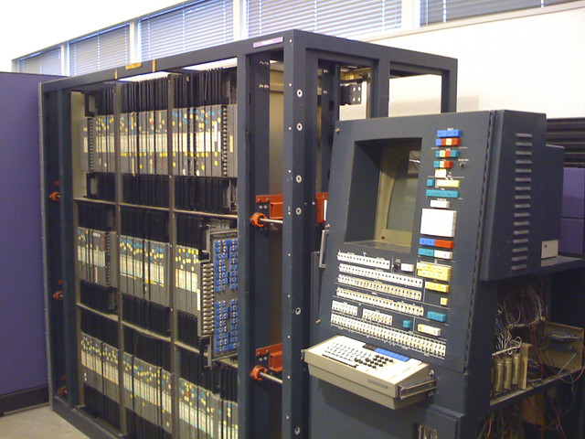
ILLIAC IV, 1966
This was the machine that first used the concept of SIMD

Slide 51
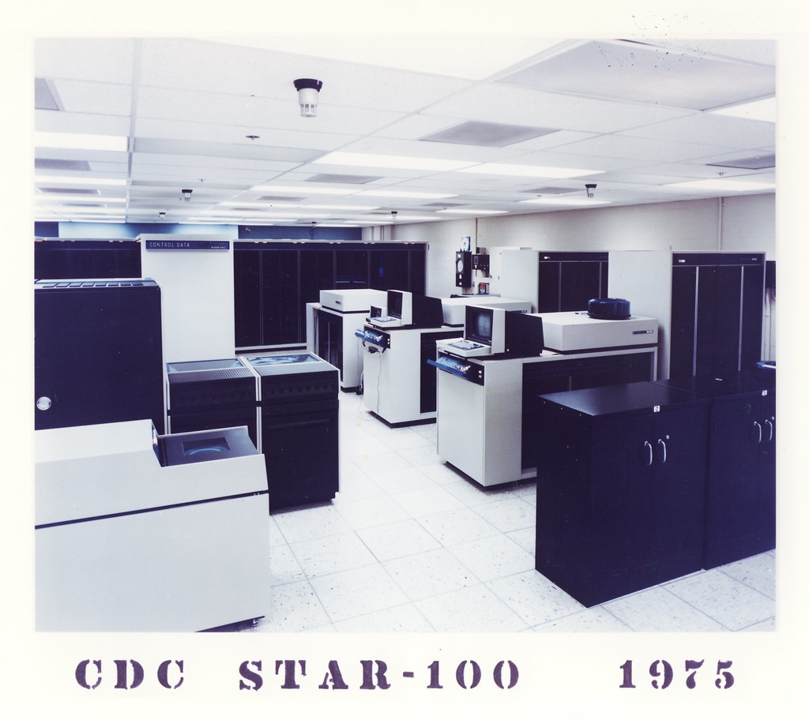
CDC STAR-100, 1974
Was one of the first machines to use vector processors to speed up scientific applications
Was the first supercomputer to use ICs and the first supercomputer that was equipped with a million words of computer memory

Slide 52
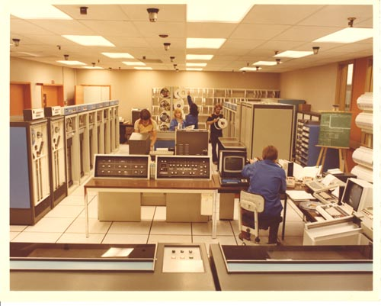
TEXAS INSTRUMENTS ASC, 1973
A first-generation vector processing machine
Was early to implement but inefficient in vector processing, much like the CDC STAR 100,which was introduced in the same year

Slide 53
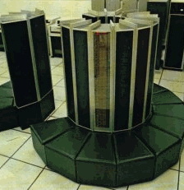
CRAY – I, 1976
Was one of the first and most successful supercomputers
Removed limitations of CDC star-100 and Texas instruments asc, to multiply performance by several times

Slide 54
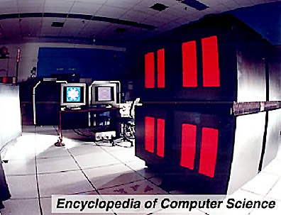
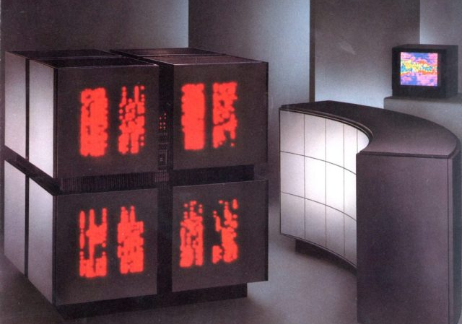
THINKING MACHINES CM-1 and CM-2, early 80's
Were massively parallel supercomputers that emulated SIMD

Slide 55
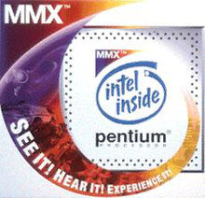
Intel's MMX extensions to the x86 architecture - 1996
In the 90's, desktop computers which used SIMD had become powerful enough to support real-time gaming & audio/video processing
Intel's MMX extensions to the x86 architecture were the first widely deployed SIMD in desktop computers

Slide 56
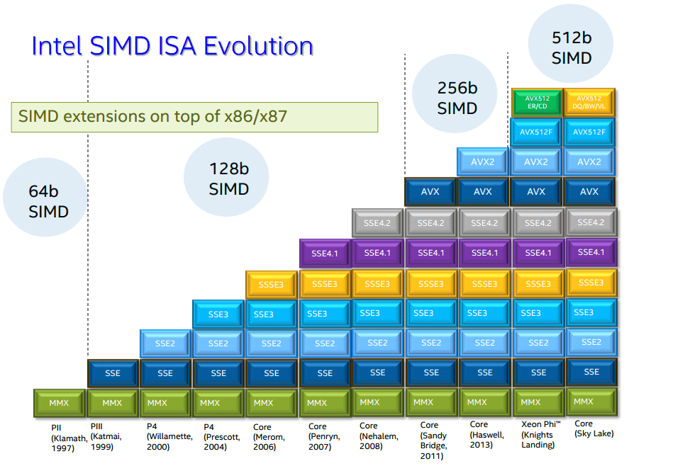
How Intel has developed SIMD extensions on x86/x87 till today

Slide 57
SIMD in today's world
Modern desktop computers are multiprocessor MIMD computers where each processor executes short-vector SIMD instructions
Modern supercomputers are a cluster of MIMD computers, each implementing short-vector SIMD instructions

Slide 58
3. MISD systems
A brief analysis of real-world existence of MISd

Slide 59
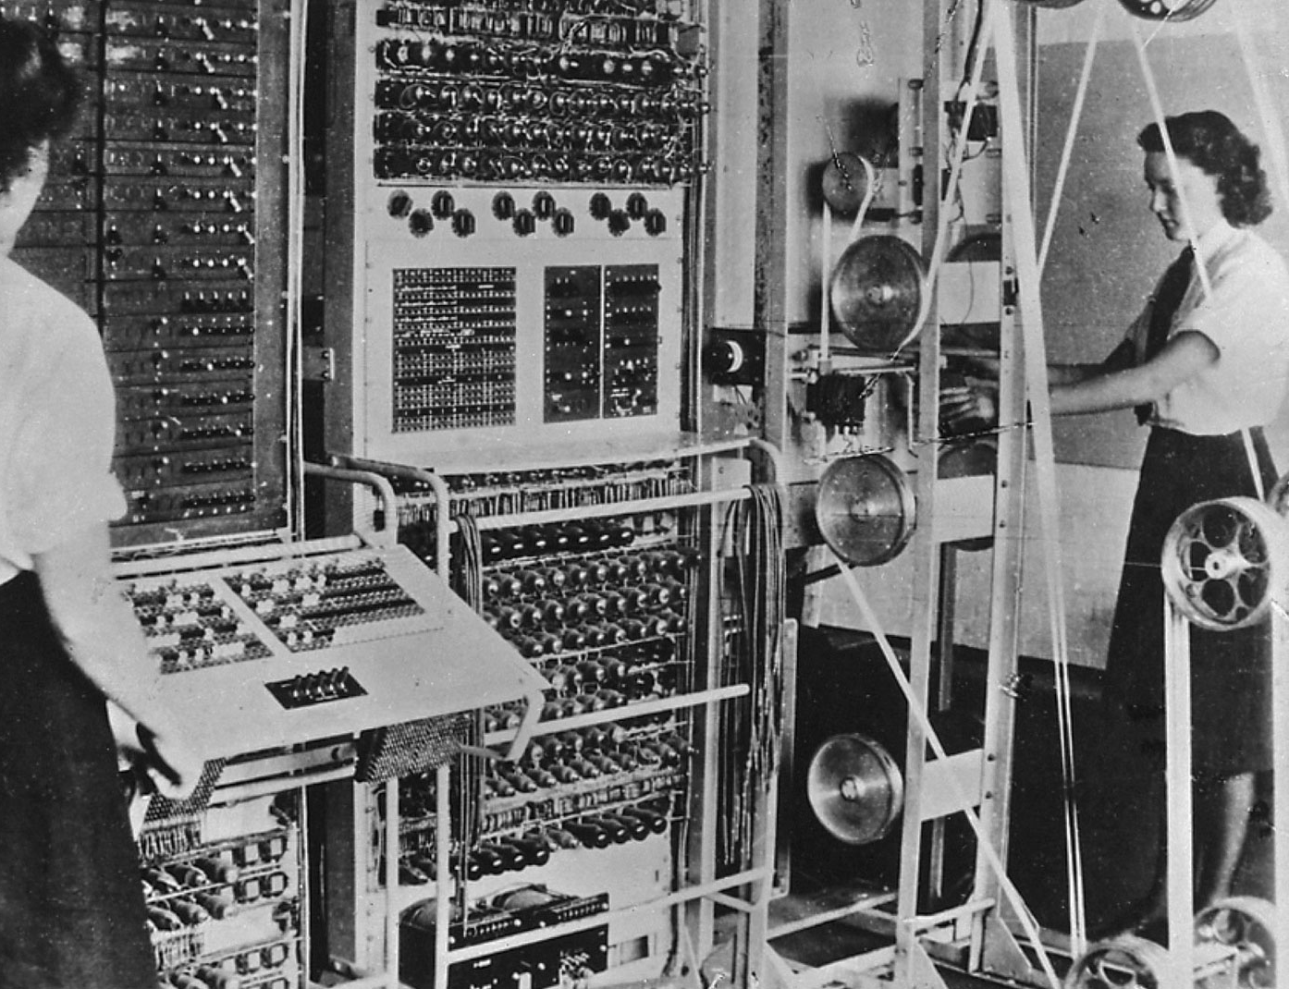
MISD Systems
Pipeline Architectures and Fault tolerance(for error detection) using task replication are examples of MISD
Systolic Arrays, published in 1979 by Kung and Leicerson, emulates MISD
However, the first machine to use a concept similar to systolic arrays dates back to the Colossus Mark II, in 1944!

Slide 60
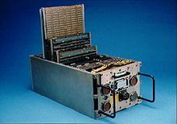
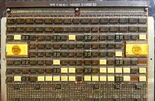
IBM System/4 Pi, 1967
Was used in the family of Space Shuttle Flight computers
Is one of the very few machines that actually implemented MISD

Slide 61
4. MIMD Systems
A brief look at the most promising category of computers

Slide 62
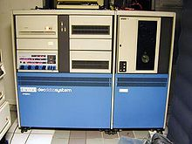
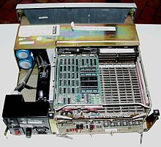
DEC-PDP-11, early 70's
One of the most successful minicomputers of all time
The experimental C.mmp and CM* projects (1971) at Carnegie Mellon used DEC-PDP-11s
Samuel C.C. Ting used a DEC-PDP-11 for his experiments in discovering J/ψ meson, which fetched him his Nobel prize in '76

Slide 63
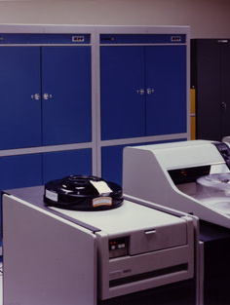
Goodyear MPP, 1983
Massively parallel processing computer built by Goodyear Aerospace, for the NASA Goddard Space Flight Center
Designed to deliver enormous computational power at a lower cost than other existing supercomputer architectures at that time

Slide 64
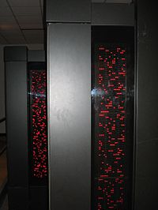
FROSTBURG - THINKING MACHINES CM-5, 1991
Was the first massively parallel supercomputer bought by the NSA, to perform higher-level mathematical calculations
The OS CMost was based on UNIX, but optimized for parallel processing

Slide 65
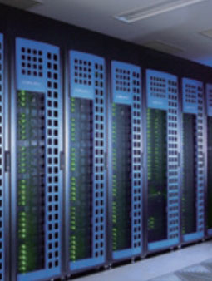
Intel Xeon Phi, 2010
Series of x86 manycore processors, designed for supercomputers and high-end workstations
Based on Intel's earlier GPU design and thus shares areas of applicability with GPUs

Slide 66
Most parallel computers today are MIMD computers
Owing to their diversity and high performance,

Slide 67
What about other taxonomies?
Flynn was not the only one to propose a taxonomy for computers. Here is a look at a few other taxonomies proposed...

Slide 68
Other Taxonomies
Shore – Based on how computer is organized from its constituent parts. 6 different types distinguished by a numerical designator
Bell – A taxonomy exclusive for MIMD machines
Feng – Based on the number of bits processed simultaneously
Hockney and Jesshope – Most ambitious taxonomy where processors where classified similar to chemical notation for organic compounds. Was successfully exhaustive of all systems but too complex

Slide 69
Why is Flynn's Taxonomy most successful?
Even with so many other options,

Slide 70
Perks of Flynn's Taxonomy
It is an exhaustive taxonomy
When computing systems could not be accommodated within, it could be expanded incrementally without modifying the core basis(SPMD/MPMD)
It is a fairly simple taxonomy, easy to understand
It is very well established and most widely used

Slide 71
SUMMARY
So, to wrap it up...

Slide 72
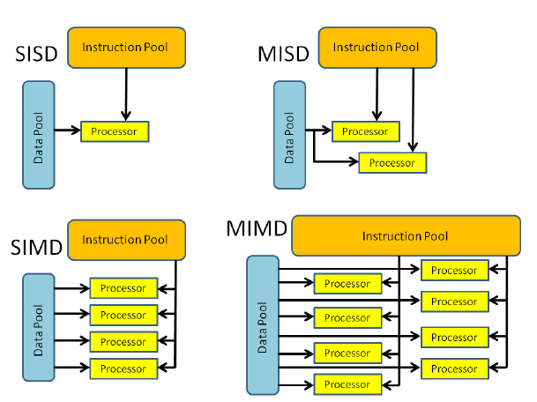
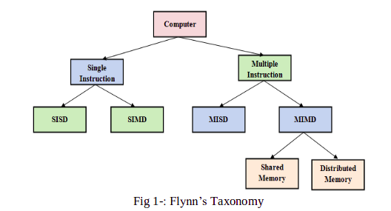
The essence of Flynn's Taxonomy

Slide 73
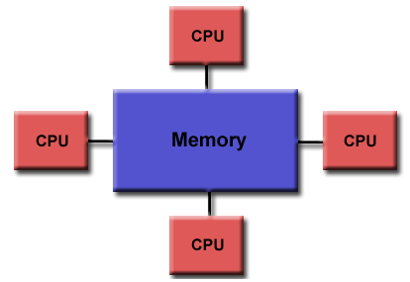
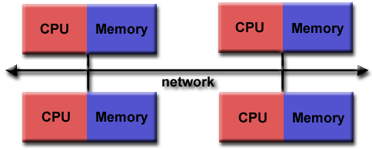
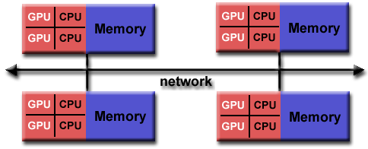
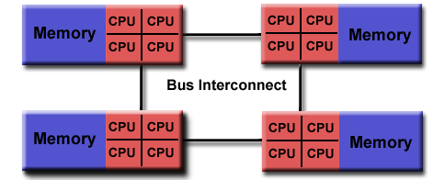
DISTRIBUTED-MEMORY
SHARED-MEMORY UMA
HYBRID DISTRIBUTED-SHARED MEMORY
SHARED-MEMORY NUMA

Slide 74

THANK YOU!
- Pratyush V Moorthy
COe18B042

